Slide 1
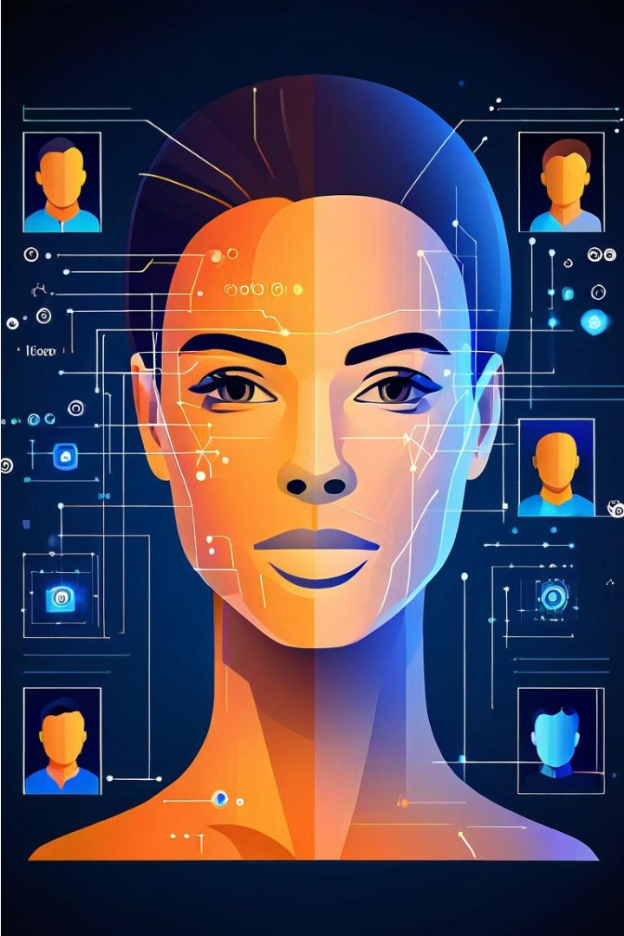
Facial Recognition
By: Ryan Brennan, Alan Baxley, Tyler Wallace

Slide 2
Project Overview and Timeline
Combining Datasets
1
Start by merging the FIFTYONEFIFTY image dataset with our own custom images to create a new, more diverse dataset.
2
Preprocessing
Preprocess all images using YOLO to resize them to 224x224 RGB, preparing them for feature extraction.
Feature Extraction
3
Extract features from the preprocessed images using average pooling and the ResNet50 model.

Slide 3
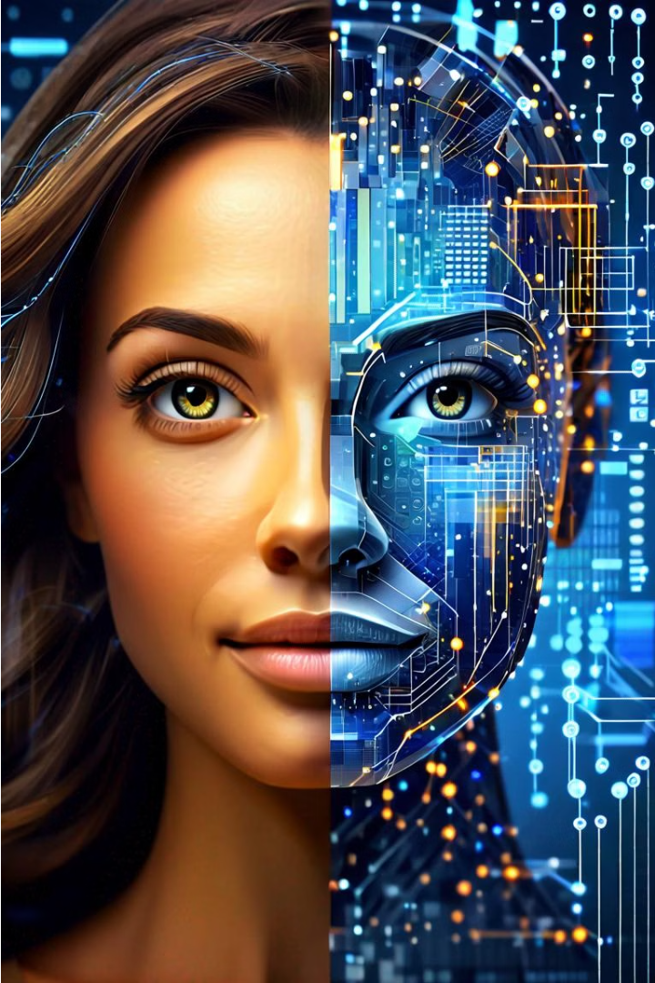
Combining FIFTYONEFIFTY and Custom Images
We're combining the FIFTYONEFIFTY dataset with our own custom images to create a diverse dataset for our facial recognition project. This combined dataset will improve the performance and accuracy of our system by including a wider range of facial diversity, expressions, and real-world scenarios.

Slide 4
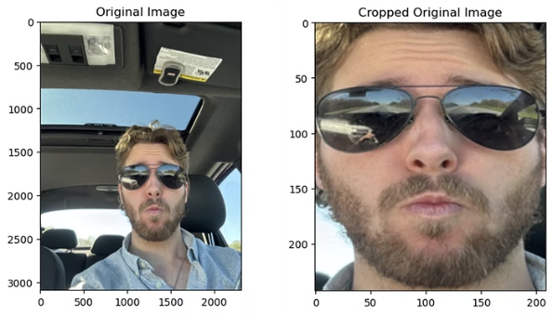
Preprocessing images
1
Combine Datasets
2
YOLO Face Cropping
3
Image Resizing
After combining the FIFTYONEFIFTY dataset and our custom images, we preprocess the images for feature extraction.
We resize and convert the images to the optimal size and format (224x224 RGB) for the ResNet50 feature extractor.
Using YOLO, we crop the key faces in the images, removing background clutter.

Slide 5

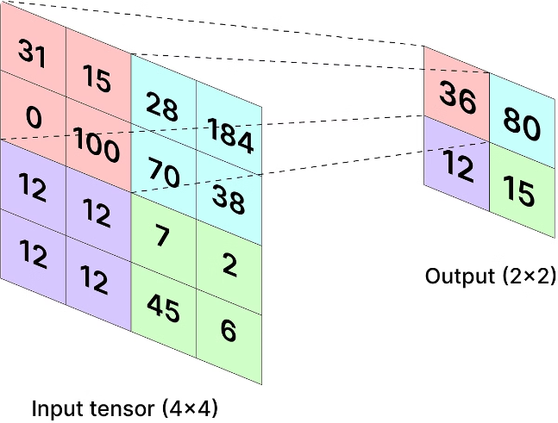
Extracting features using average pooling and ResNet50
Purpose: ResNet, short for Residual Network, is a type of convolutional neural network (CNN) used primarily for image classification and recognition tasks, known for its ability to train very deep networks effectively.
Mechanism: It introduces residual blocks with skip connections that allow gradients to flow through the network directly, preventing the problem of vanishing gradients and enabling the training of much deeper networks than was previously feasible.

Slide 6

Storing Features with FAISS
Index Configuration: Employed IndexFlatL2 for accurate similarity searches with options for Product Quantization to enhance efficiency in large datasets.
Integration and Performance: Integrated directly with ResNet outputs for real-time indexing and optimized parameters to ensure quick retrieval and scalability.

Slide 7

Query the Database
We use YOLO to detect key objects and features, including human faces, in the new image. This helps us crop out unwanted parts and focus on the important areas.
We compare the extracted features of the new image to our FAISS database using the L2 Euclidean distance. The image with the closest features in the database is considered the best match.

Slide 8

Potential applications and use cases
Facial recognition and biometrics for security and access control 🔒
Personalized recommendations and recommendations for content, products, or services 🎯
Detecting and preventing identity fraud 🚨

Slide 9
Our Contribution
Expanded Dataset
Advanced Preprocessing
Our team combined the FIFTYONEFIFTY dataset with custom-captured images, creating a more diverse and comprehensive dataset for facial recognition.
We leveraged YOLO to precisely crop and resize all images to 224x224 RGB, optimizing the input for deep learning models.
Robust Feature Extraction
Efficient Storage
By utilizing average pooling and ResNet50, we were able to extract highly accurate and discriminative facial features.
Integrating our features with Facebook AI Similarity Search (FAISS) allows for fast and scalable facial matching capabilities.

